Slide 1
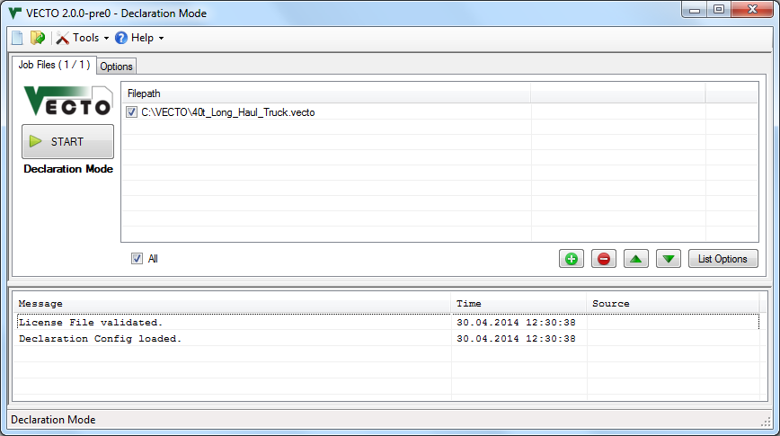
Job List
Message List
Statusbar

Slide 2
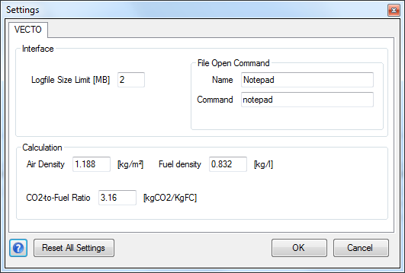

Slide 3
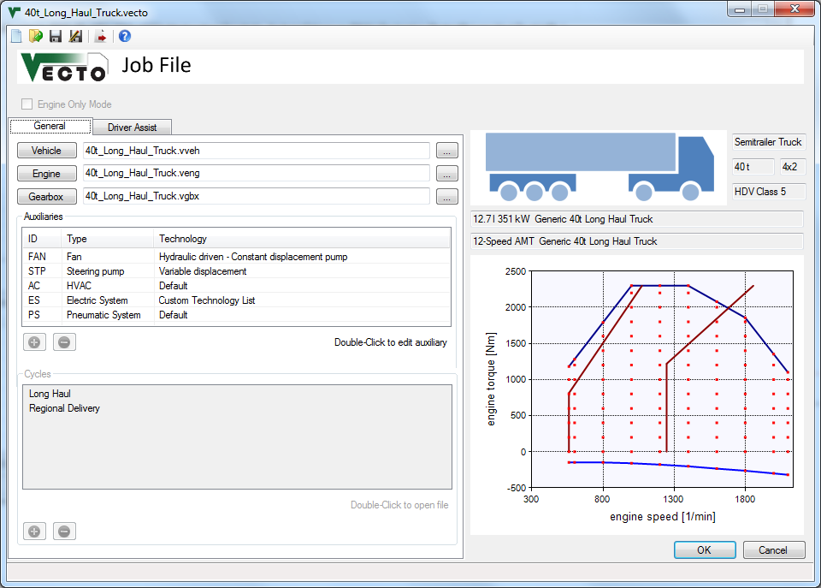
Chart Area

Slide 4
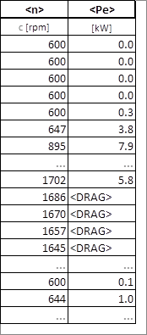
Engine motoring operation. Can also be used with <Me>

Slide 5
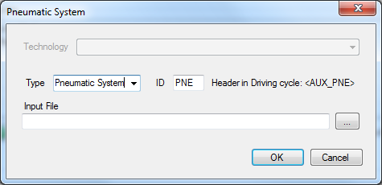
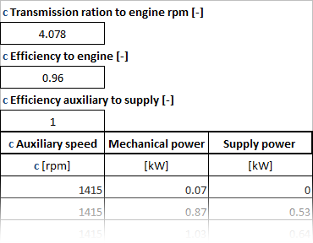

Slide 6
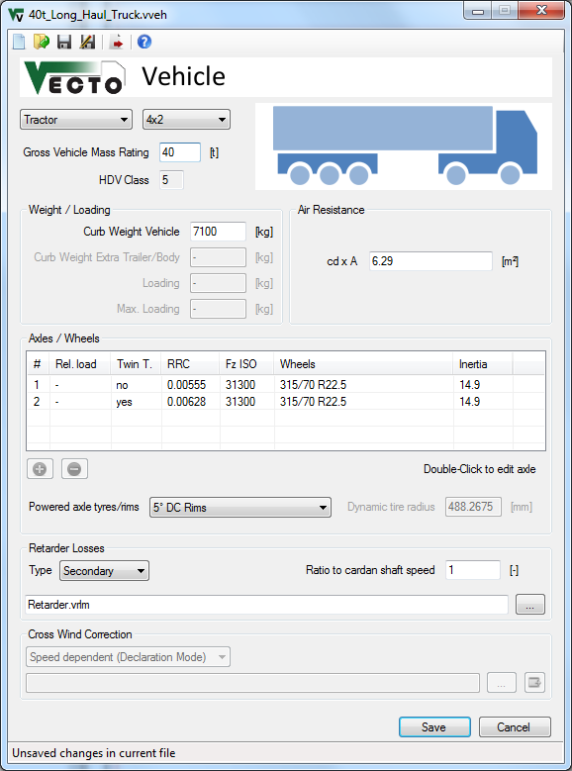
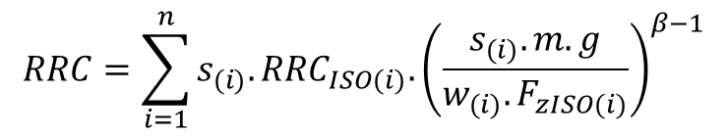
$$RRC=\sum_{i=1}^{n}{{s_{(i)}.RRC}_{ISO(i)}.{\left(\frac{s_{(i)}.m.g}{{w_{(i)}.F}_{zISO(i)}}\right)}^{β−1}}$$

Slide 7
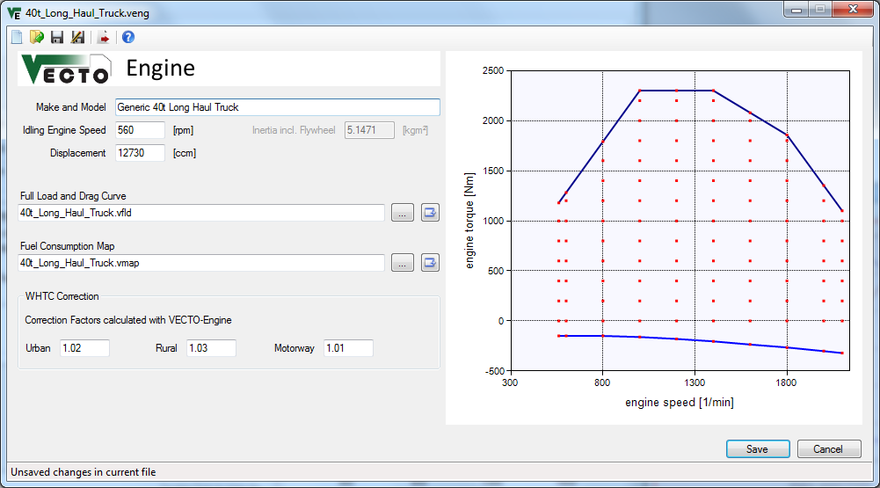
Chart Area

Slide 8
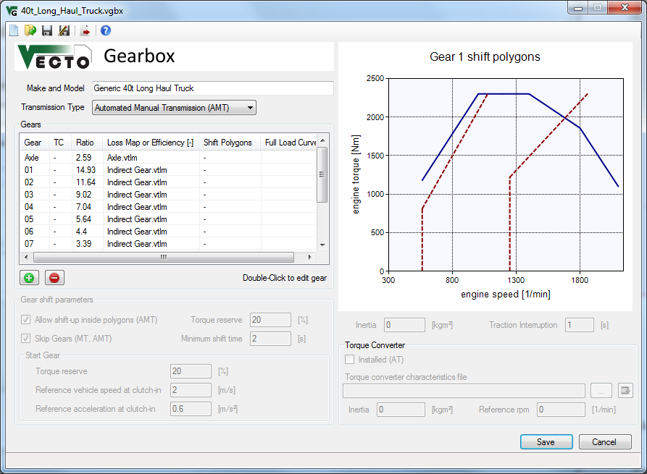
Chart Area
$$Output Torque=\left(Input Torque−Torque Loss\right)×GearRatio$$

Slide 9
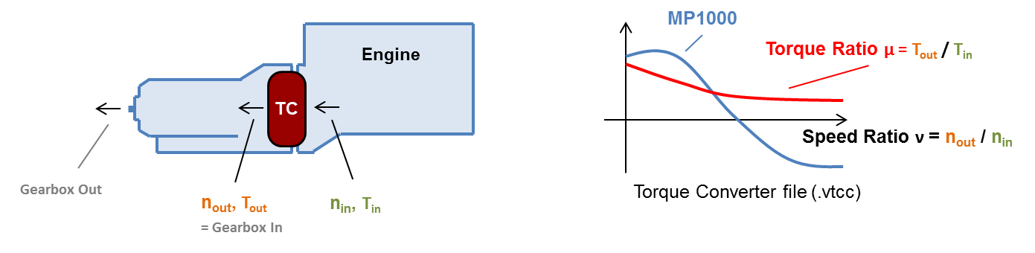
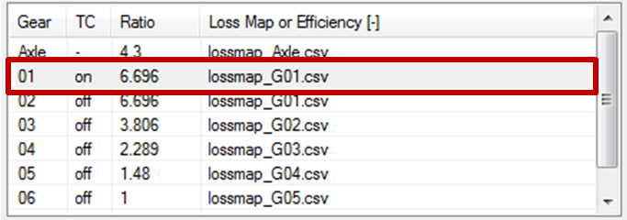
Original in Release Notes.pptx

Slide 10
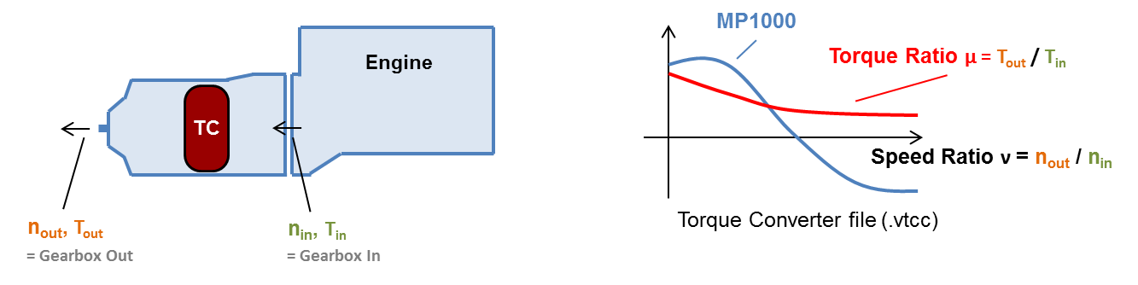
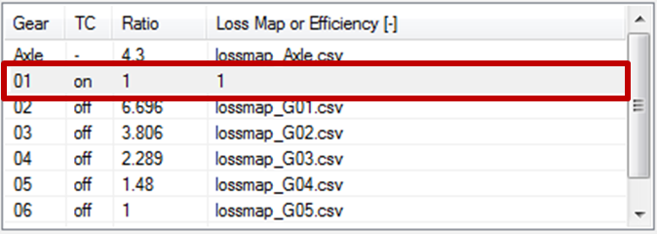
Original in Release Notes.pptx

Slide 11
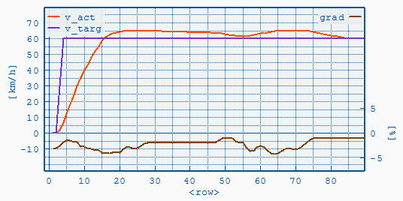
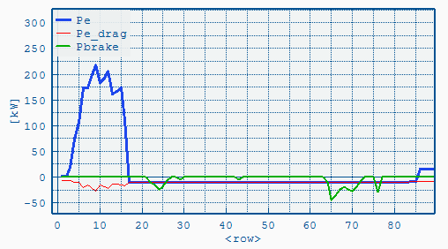
Coasting with Brakes applied if Overspeed is reached

Slide 12
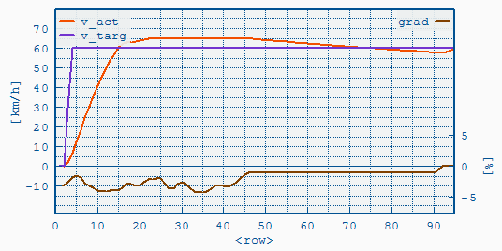
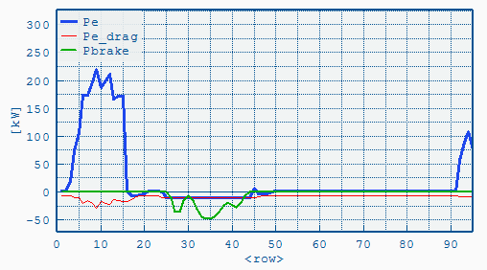
Overspeed reached:
Coasting & Braking
Engine idling

Slide 13
T = (vset₁-vset₂) / a_{lookahead} e.g. a_{lookahead} = -0.5m/s²
V
Vset₁
Deceleration according to a_{brake}=f(v)-curve e.g. = -1m/s²
coasting phase
resulting vehicle speed course
Vset₂
time

Slide 14
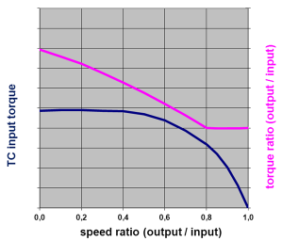
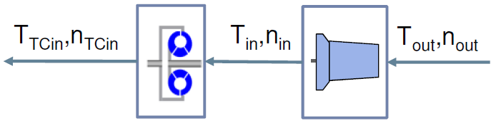
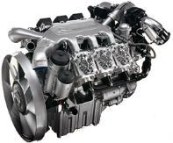
Torque converter characteristic (.vtcc file)
Quasi stationary backwards calculation
Transmission losses added
Longitudinal dynamics
Iteration
Engine
Torque converter
Transmission

Slide 15
.vaux file
.vdri file
TransRatio
EffToEng
EffToSply
AuxMap(n,Pe)
Psupply

Slide 16
1) n_{Aux} = n_{Eng} * TransRatio
with: n_{Eng} = engine speed
2) P_{AuxOut} = Psupply / EffToSply
3) P_{AuxIn} = AuxMap(n_{Aux}, P_{AuxOut})
4) P_{AuxDemand} = P_{AuxIn} / EffToEng
P_{AuxDemand} is directly added to the engine's power demand

Slide 17
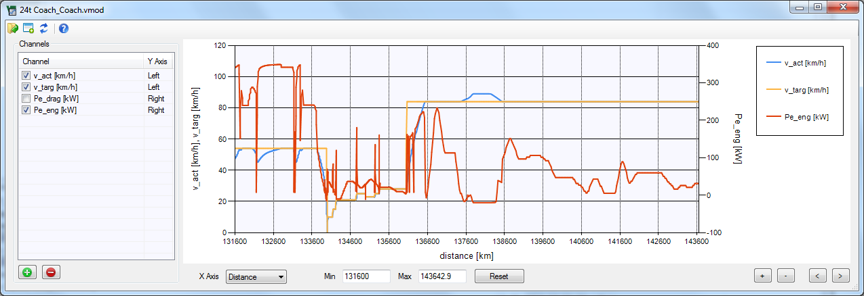

Slide 18
AxleGear
(AngularGear)
(Retarder primary)
Gearbox
Driving Cycle
Driver
Vehicle
Wheels
Brakes
(Retarder secondary)
Clutch
Engine
Auxiliaries
Driving Cycle
Driver
Vehicle
Wheels
Brakes
AxleGear
(Angular
Gear)
(Retarder primary)
Gearbox
(Retarder secondary)
Clutch
Engine
Auxiliaries
Gearshift Strategy

Slide 19
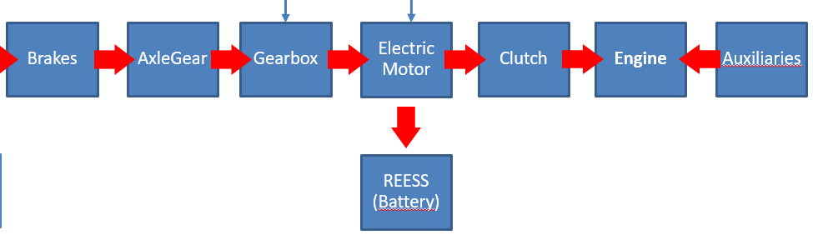
Hybrid Controller
EM Ctl
Gearshift
Driving Cycle
Driver
Vehicle
Wheels
Brakes
AxleGear
Gearbox
Electric Motor
Clutch
Engine
Auxiliaries
Hybrid Strategy
REESS (Battery)
Test Powertrain

Slide 20
Hybrid Strategy
DryRun Request with EM Off
Get ICE operating point, get EM max drive and max recuperation torque
Iterate EM torque (u)
Try different gears (similar to gearshift strategy)
Select best solution (cost function)

Slide 21
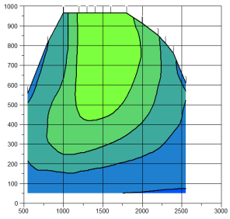



AMT – Transmission Output Retarder
P_pto_transm
P_pto_consum
engine
clutch
P_aux
P_eng_out
P_clutch_out
P_gbx_in
P_eng_inertia
P_fcmap
P_clutch_loss
gearbox
retarder
angle transm.
P_gbx_loss
P_angle_loss
P_gbx_in
P_ret_in
P_angle_in
P_gbx_inertia
P_ret_loss
P_axle_in

Slide 22


Axle
P_axle_in
wheel
axle
transm.
brake
P_axle_loss
P_brake_in
P_wheel_in
P_brake_loss
P_wheel_inertia
P_trac

Slide 23
AMT – Transmission Input Retarder
P_pto_transm
P_pto_consum
engine
clutch
P_aux
P_eng_out
P_clutch_out
P_ret_in
P_eng_inertia
P_clutch_loss
P_fcmap
retarder
gearbox
angle transm.
P_axle_loss
P_angle_loss
P_ret_in
P_gbx_in
P_angle_in
P_gbx_inertia
P_ret_loss
P_axle_in

Slide 24
AT – Transmission Output Retarder
P_pto_transm
P_pto_consum
engine
torque conv.
P_aux
P_eng_out
P_tc_in
P_gbx_in
P_tc_loss
P_eng_inertia
P_fcmap
gearbox
retarder
angle transm.
P_gbx_loss
P_angle_loss
P_gbx_in
P_ret_in
P_angle_in
P_gbx_inertia
P_ret_loss
P_axle_in

Slide 25
AT – Transmission Input Retarder
P_pto_transm
P_pto_consum
engine
retarder
P_aux
P_eng_out
P_ret_in
P_tc_in
P_eng_inertia
P_ret_loss
P_fcmap
torque conv.
gearbox
angle transm.
P_gbx_loss
P_angle_loss
P_tc_in
P_gbx_in
P_angle_in
P_tc_loss
P_gbx_inertia
P_axle_in

Slide 26

IEPC
Transmission
Electric Motor
n_IEPC_avg
i_gear
n_IEPC_int_avg
Inertia
Power Maps
T_IEPC_out
T_IEPC_int
Drag Curve

